Slide 1

NSS PORTAL
Pranav Pawar- 121A1074
Aayush Shah-121A1098
Dhruv Shetty-121A1101
Avishkar Phawade-121A1076
--Project Guide--
Prof.Swapnil Wani

Slide 2
INTRODUCTION:
The National Service Scheme (NSS) is an Indian government-sponsored public service program conducted by the Department of Youth Affairs and Sports of the Government of India. Popularly known as NSS, the scheme was launched in Gandhiji's Centenary year, 1969.
The cardinal principle of the NSS program is that it is organized by the students themselves, and both students and teachers through their combined participation in community service, get a sense of involvement in the tasks of nation building.
Aimed at developing student's personality through community service, NSS is a voluntary association of young people in Colleges, Universities and at +2 level working for a campus-community linkage

Slide 3
OBJECTIVES:
Keeps records of past activities performed within the last years.
Displaying all the necessary information about the volunteers such as their name, department, and their profile.
We generate reports so no need for paper works to store the data.
The admin can add events in the portal, So Students can join their interested events.

Slide 4
LITERATURE SURVEY:
All the colleges or educational institutions which are part of NSS had been doing things offline.
When an event is organized by the college NSS team, the information usually reaches the candidates of NSS through a meeting.
To contact the NSS team or get any information about anything, the respective person has to visit the NSS Team of their respective colleges.
This makes the information exchange difficult and slow.

Slide 5
PROPOSED SYSTEM:
A user-friendly system, with a great User Interface and easy-to-use controls.
The proposed system contains an application that the users can use to gain information, communicate and keep a record of all the activities done in the past.
The application uses MYSQL as a database, we can keep a backup of the database to safe keep it from system crashes.
The Web Application of NSS will have a login, where a registered user can log in and access the available information

Slide 6
METHODOLOGY:
Goals:
To remove a huge gap in interactions between volunteers and the system.
Provide all necessary information.
Requirements:
We use HTML, CSS, and PHP as a language and MYSQL as a database.
Implementation:
Running and testing code in VS code editor.
Design:
The following picture shows the interface portal and admin and login page.

Slide 7
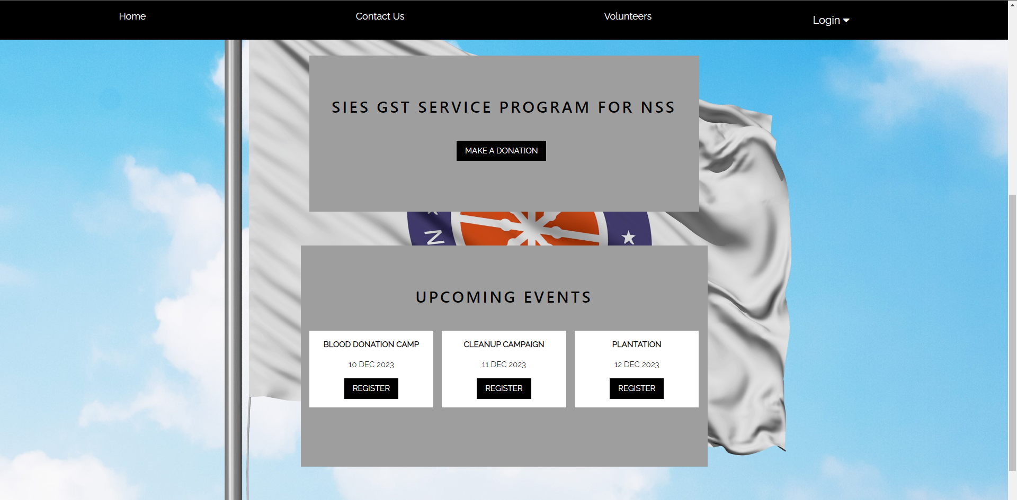

Slide 8
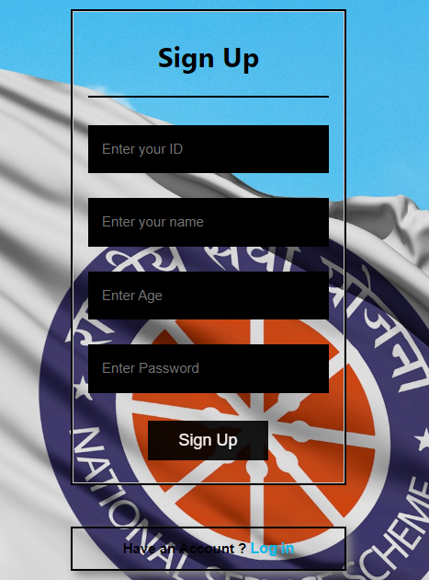
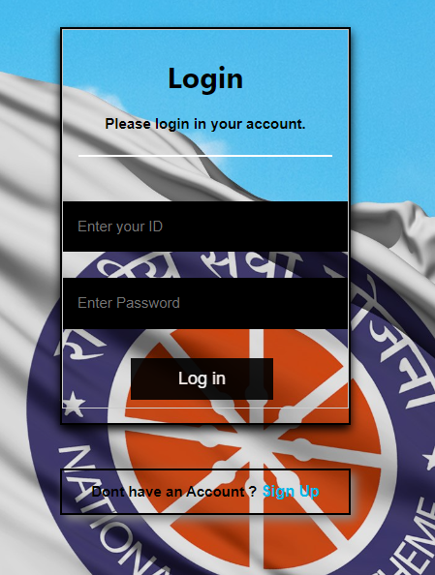

Slide 9
FUTURE SCOPE:
Integrating a payment gateway to the NSS college unit website can be a great way to accept online donations from supporters across the world.
A payment gateway is a third-party service that authorizes payments for online businesses, and it can accept payments from various sources such as credit cards, debit cards, net banking, and e-wallets.
By integrating a payment gateway to the website, the NSS college unit can accept donations from supporters worldwide, without any geographical barriers.

Slide 10
CONCLUSION:
College students participate in NSS to service the society and help the needy, activities like educating the poor, cleaning the surroundings, plantation, yoga, blood donation camp and other events will be conducted by the NSS team.
Through the Internet the information will be shared faster compared to offline meetings.
The idea is to create a web application where students can login and check the available information about activities, contact the organizers or contribute funds to the society.

Slide 11
REFERENCES:
https://www.grin.com/document/1280789
https://jpinfotech.org/nss-management-system/
https://nssdu.ac.in/
www.stackoverflow.com
https://ieeexplore.ieee.org/abstract/document/5661595

Slide 12
THANK YOU!!!

